Slide 1

JPEG Compression in OpenCV
An implementation of the JPEG compression algorithm in OpenCV using Discrete Cosine Transform (DCT) and without Huffman encoding

Slide 2
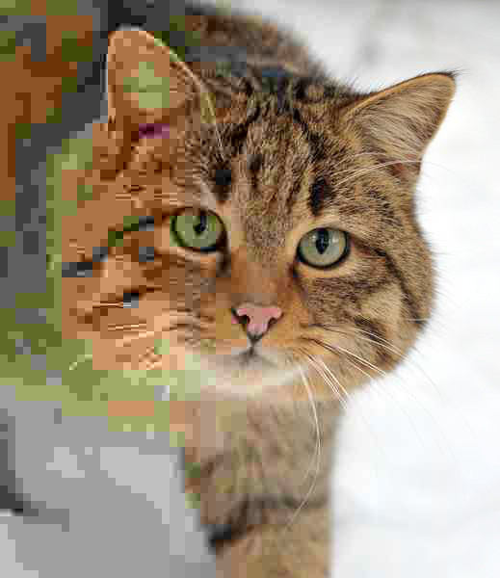
Introduction
JPEG (Joint Photographic Experts Group) is a commonly used method of lossy compression for digital images, particularly for those images produced by digital photography.
The main idea behind JPEG is to reduce image size by removing information that is less noticeable to the human eye. Instead of storing the image only as raw pixel values, JPEG transforms the image into frequency information, reduces less important details, and stores the remaining data more efficiently.

Slide 3
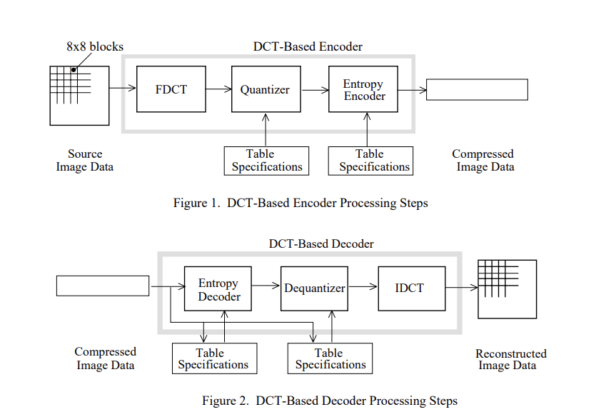
How JPEG Works
JPEG works by processing the image into 8x8 blocks, and then each block goes through a DCT-based encoder.
In this project, entropy encoding is simplified by using zigzag scanning + run-length encoding, without Huffman encoding.

Slide 4
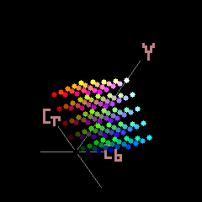
Color Space
Since our eyes are more sensitive to brightness than color, JPEG uses the YCbCr color space.
The image is converted from BGR to YCrCb:
Y = luminance / brightness
Cr = red chrominance
Cb = blue chrominance
After conversion, the image is split into 3 channels (Y, Cr, Cb).

Slide 5
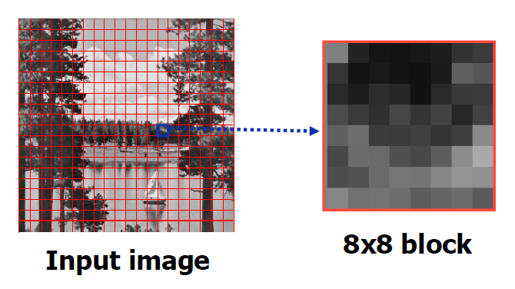
Block Splitting
After the image is converted to YCrCb and split into Y, Cr, and Cb, each channel is divided into 8×8 blocks.
JPEG processes the image block by block because the next step, DCT, is applied on small 8×8 matrices.
If the image size is not divisible by 8, padding is added.

Slide 6
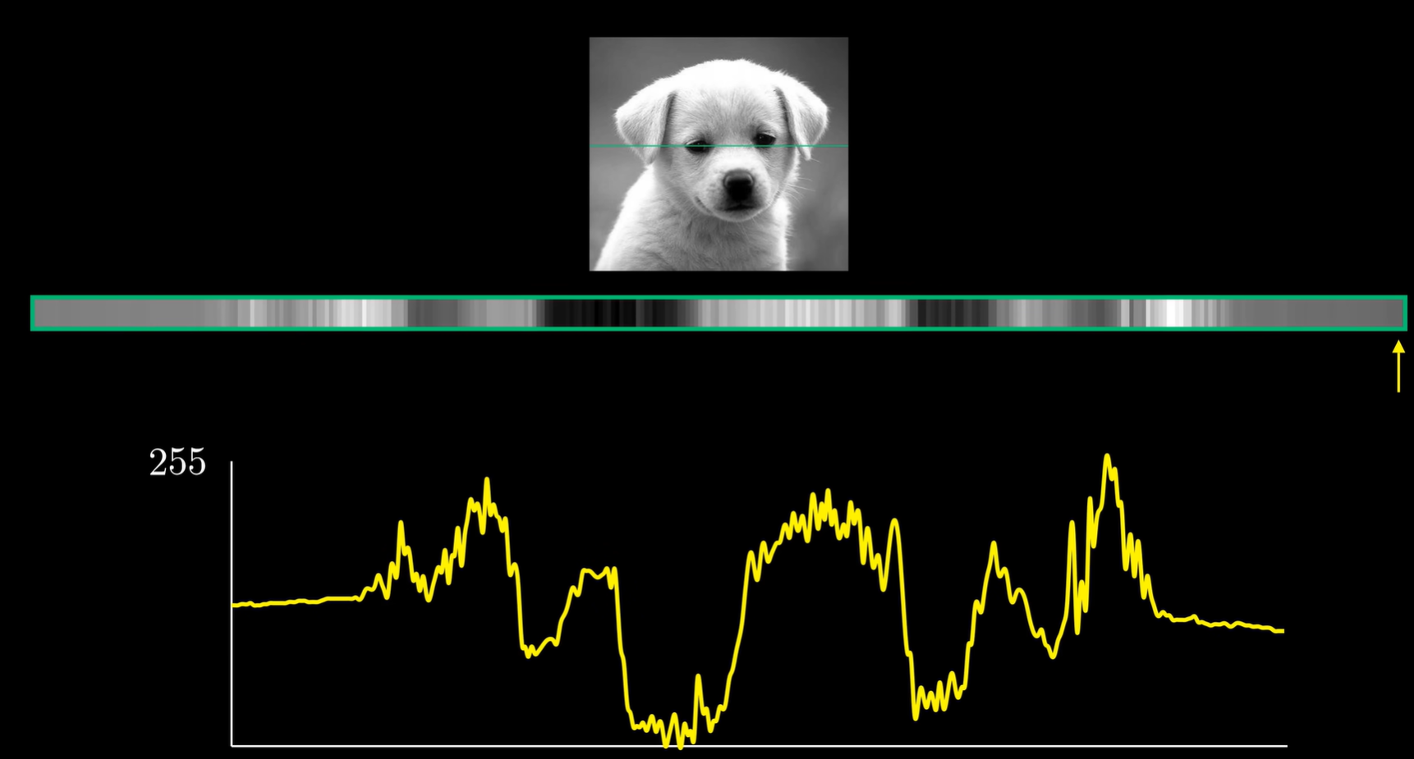
Discrete Cosine Transform (DCT)
The main ideea of JPEG is to vizualize the image as a signal. The DCT takes each 8x8 block and converts it from spatial domain to frequency domain. This means, we now works with frequency coefficients.
The main idea is that the human eye is more sensitive to low-frequency information, such as general shapes and brightness, and less sensitive to high-frequency details. JPEG uses this by keeping the low-frequency coefficients more accurately and reducing the high-frequency coefficients later during quantization.

Slide 7
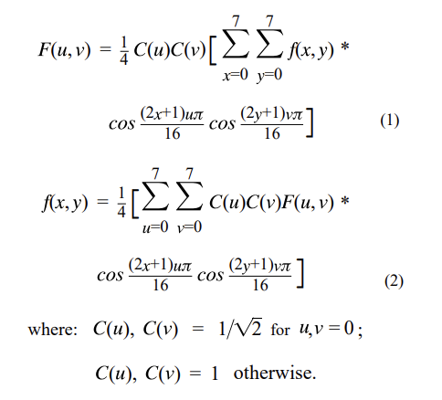
8x8 FDCT and IDCT
At the input to the encoder, source image samples are grouped into 8x8 blocks, shifted from unsigned integers with range [0, 2^{P}- 1] to signed integers with range [-2^{P-1}, 2^{P-1}-1], and input to the Forward DCT (FDCT).
At the output from the decoder, the Inverse DCT (IDCT) outputs 8x8 sample blocks to form the reconstructed image.

Slide 8
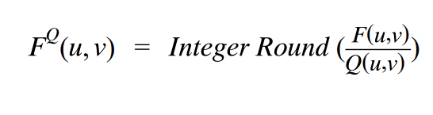
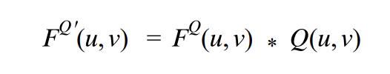
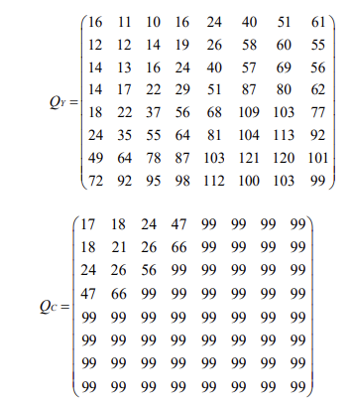
Quantization
We actually throw away data through the Quantization step. We obtain the Quantization by dividing transformed image DCT matrix by the quantization matrix used . Values of the resultant matrix are then rounded off.
Quantization aims at reducing most of the less important high frequency DCT coefficients to zero, the more zeros the better the image will compress.

Slide 9
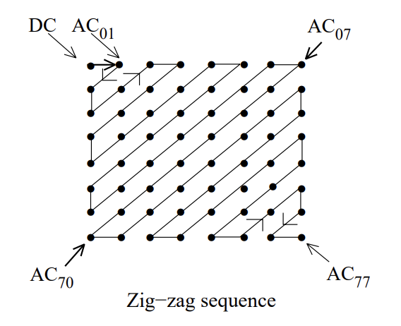
Zigzag Scanning
In the "zig-zag" sequence, firstly it encodes the coefficients with lower frequencies (typically with higher values) and then the higher frequencies (typically zero or almost zero). The result is an extended sequence of similar data bytes (sequences of zeros), permitting efficient entropy encoding.

Slide 10
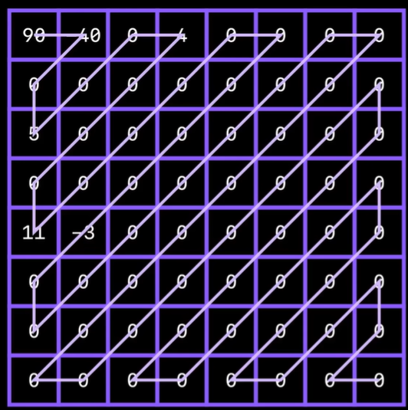
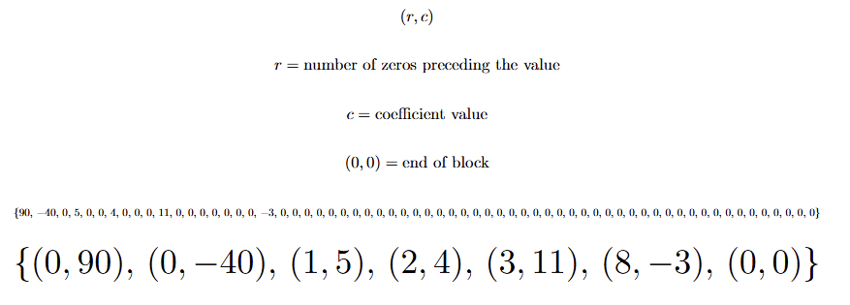
Run-length Encoding

Slide 11
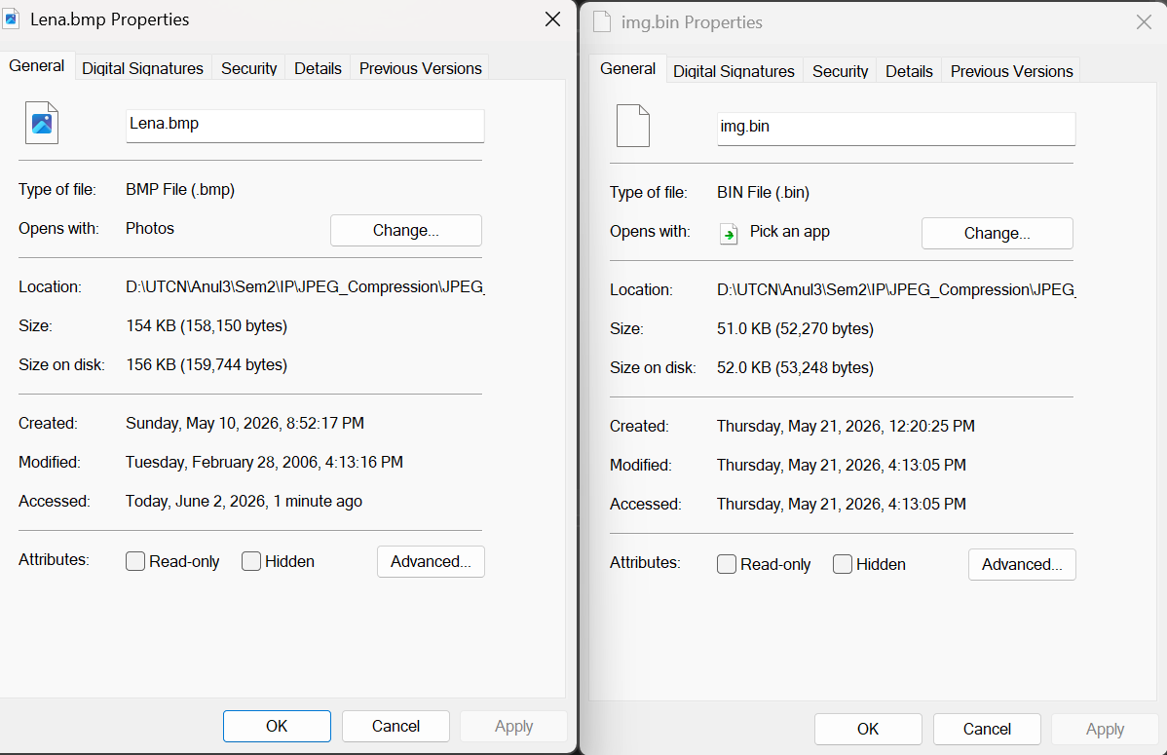
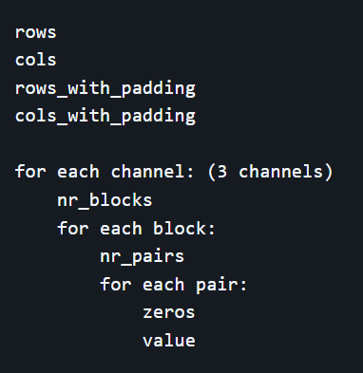
Saving the Image
The image is saved on disk as a binary file (.bin).
Using this compression method, I was able to get a compression ratio of about 3:1 for various tests.

Slide 12
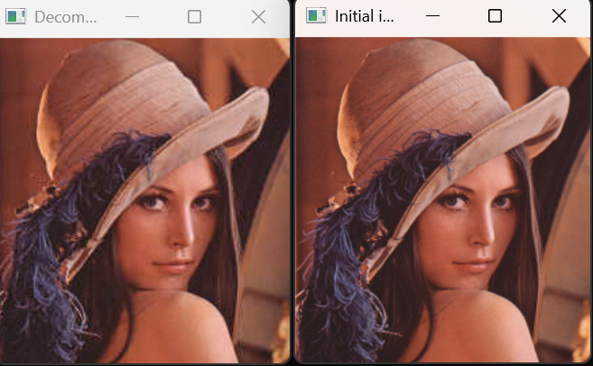
Results - Lena (compression ratio of 3.02564:1)

Slide 13
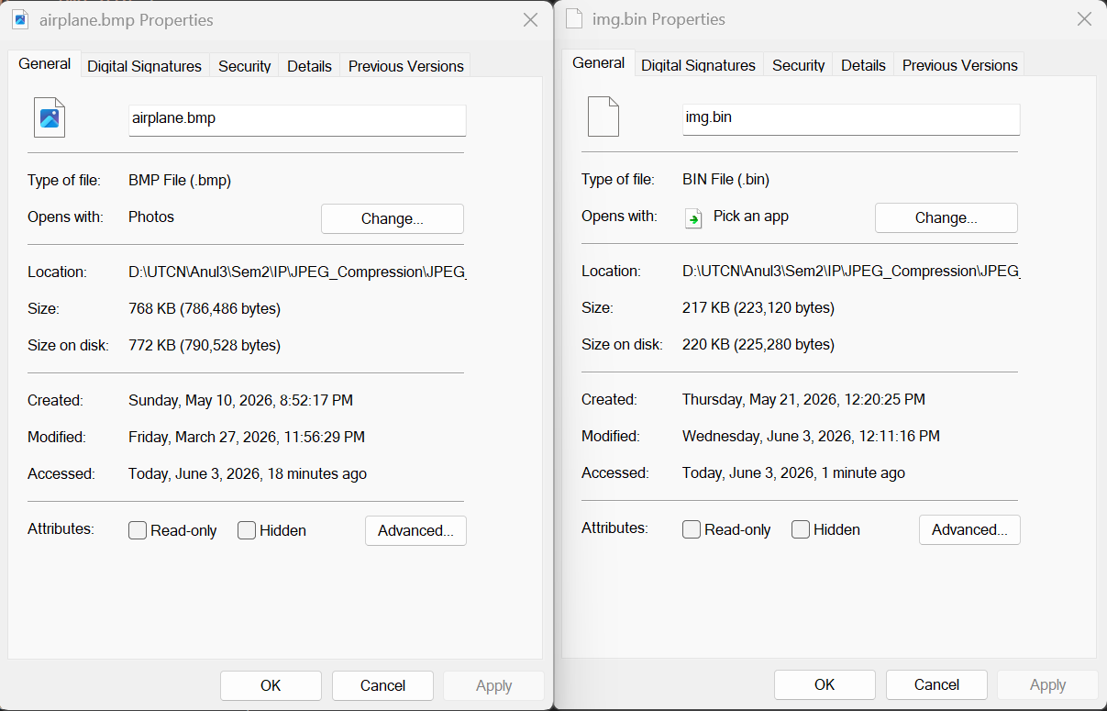
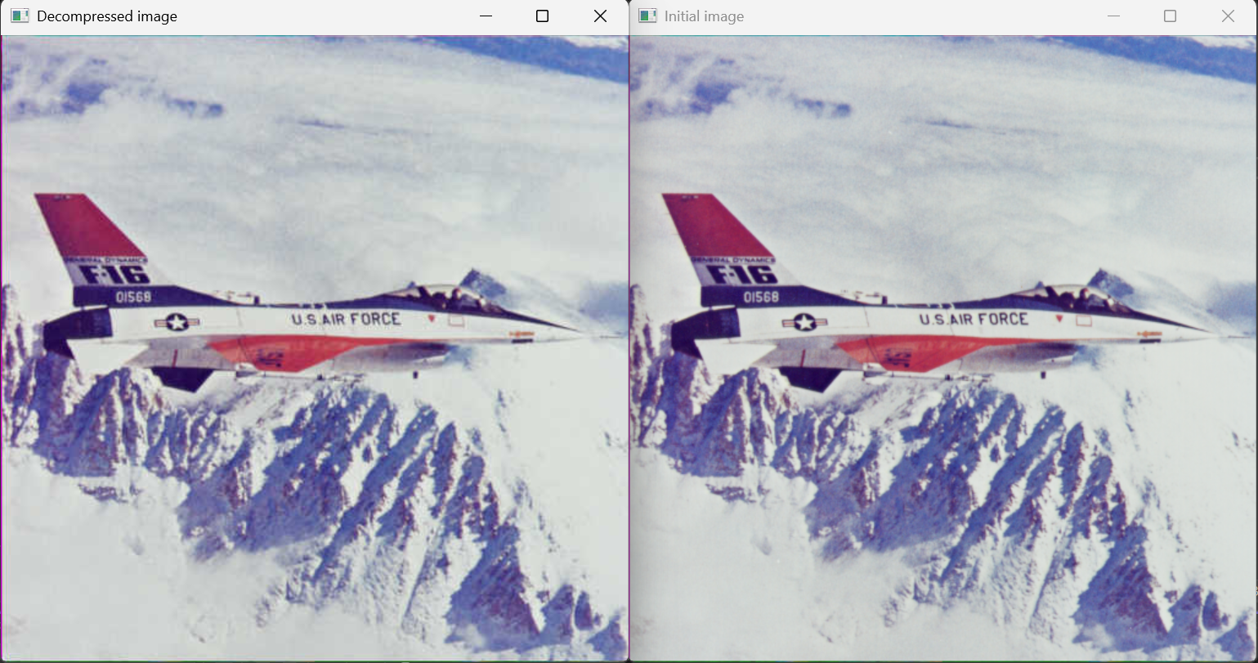
Results - Airplane (compression ratio of 3.52495:1)

Slide 14
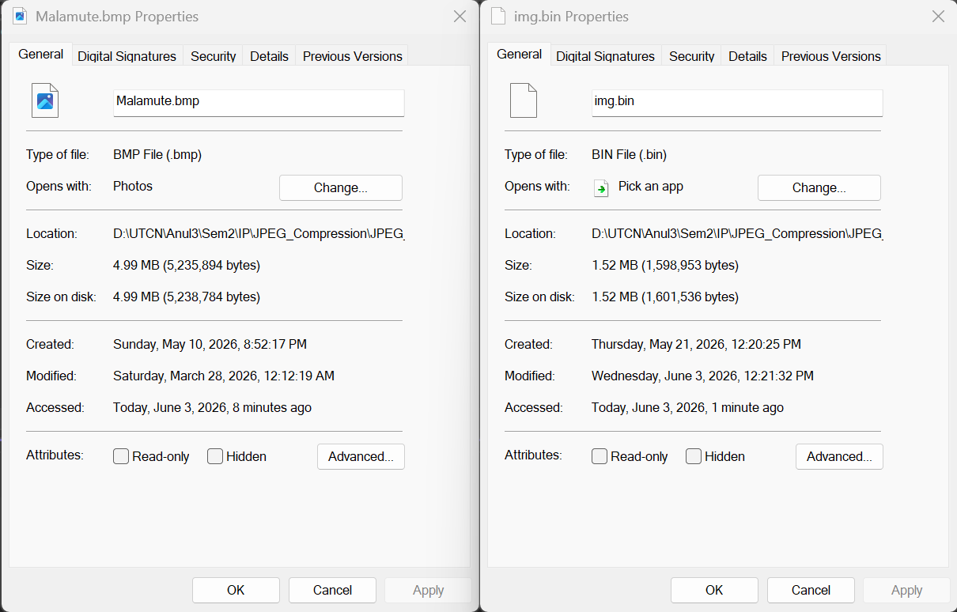
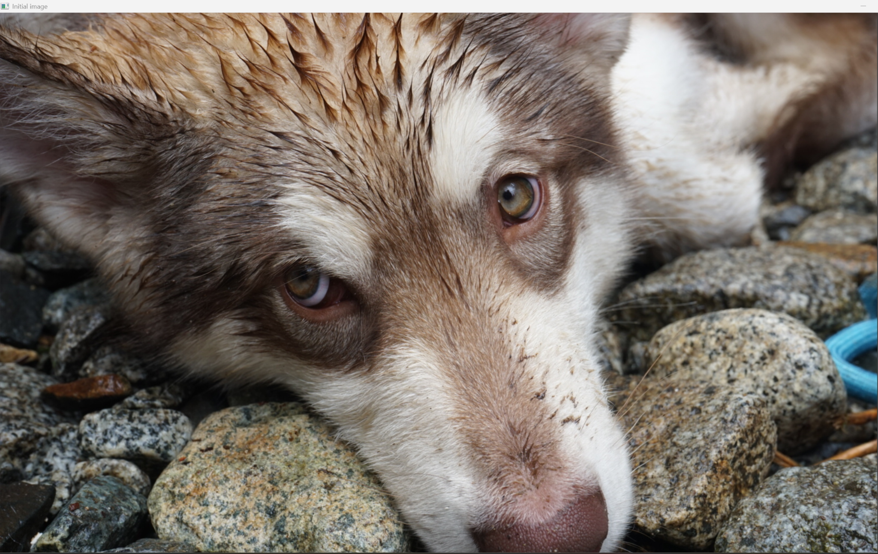

Results - Malamute (compression ratio of 3.27458:1)

Slide 15
References
G. K. Wallace, “The JPEG Still Picture Compression Standard,” Communications of the ACM, 1991.
A. M. Raid, W. M. Khedr, M. A. El-dosuky, and W. Ahmed, “JPEG Image Compression Using Discrete Cosine Transform – A Survey,” International Journal of Computer Science & Engineering Survey, vol. 5, no. 2, 2014.
Reducible, “The Unreasonable Effectiveness of JPEG: A Signal Processing Approach,” YouTube video. https://www.youtube.com/watch?v=0me3guauqOU

